Slide 1
Computer Architecture W5D2: Cache
Jian Weng
Computer Science
CEMSE, KAUST

Slide 2
Recap: What is the slowest stage?
Motivation
Memory access is slow.
We want to make it faster
How?
Understanding the concept of data hierarchy
Then we explain what are caches
IF
ID
EX
MA
WB

Slide 3
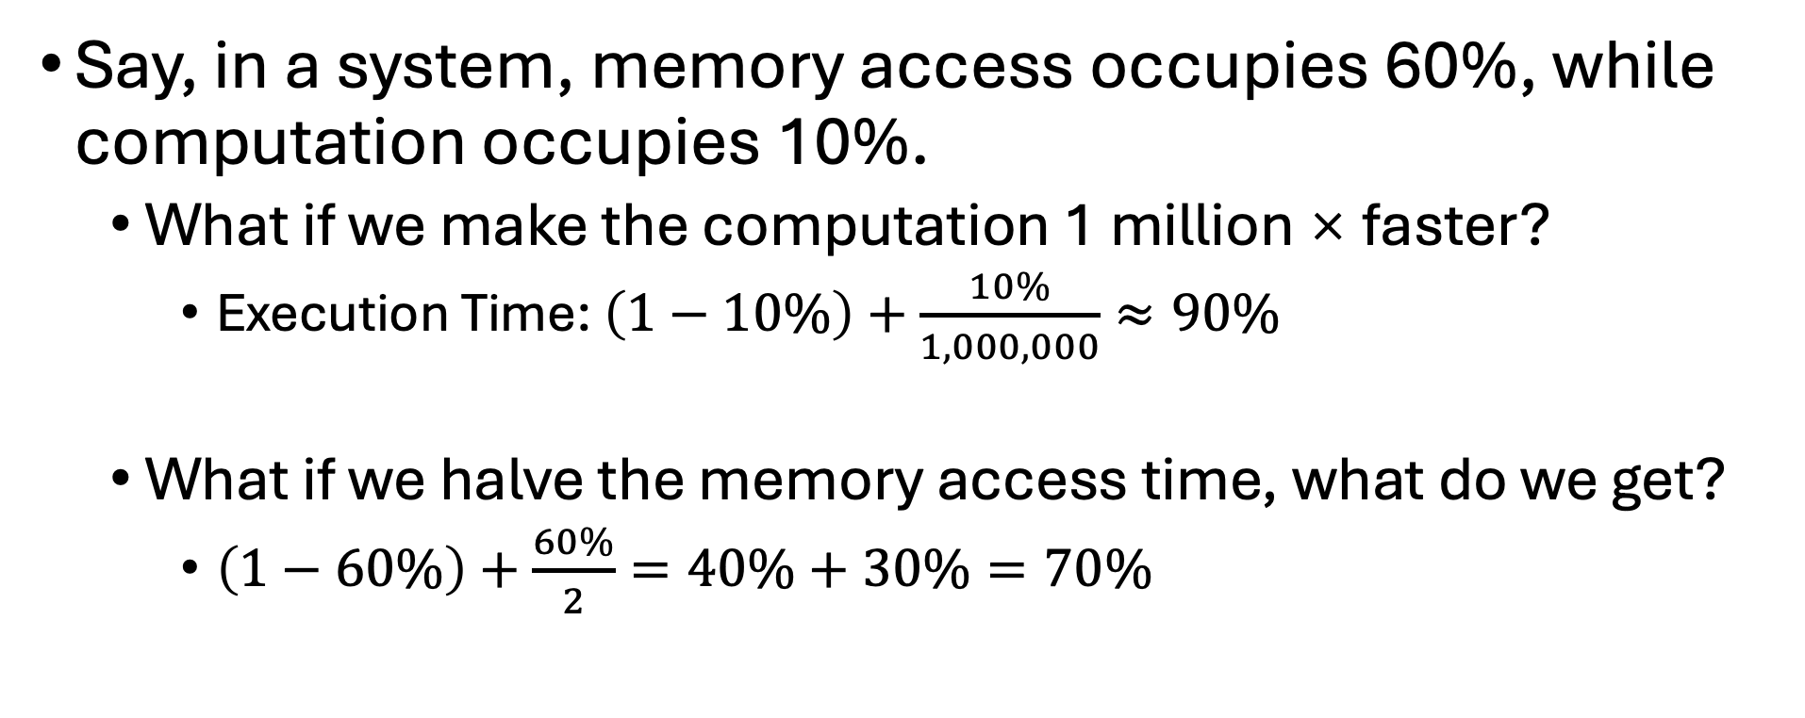
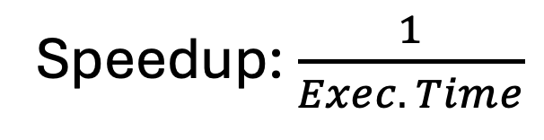
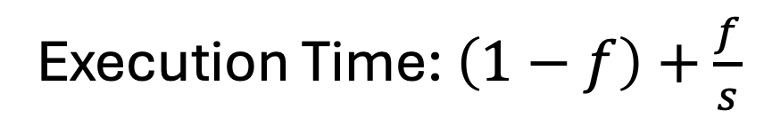
Amdahl’s Law (CONT’D)
Execution Time: $\left(1−f\right)+\frac{f}{s}$
Speedup: $\frac{1}{Exec. Time}$
Say, in a system, memory access occupies 60%, while computation occupies 10%.
What if we make the computation 1 million × faster?
Execution Time: $\left(1−10\%\right)+\frac{10\%}{1,000,000}≈90\%$
What if we halve the memory access time, what do we get?
$\left(1−60\%\right)+\frac{60\%}{2}=40\%+30\%=70\%$
The original execution time w/ optimized part excluded
Optimized execution time

Slide 4
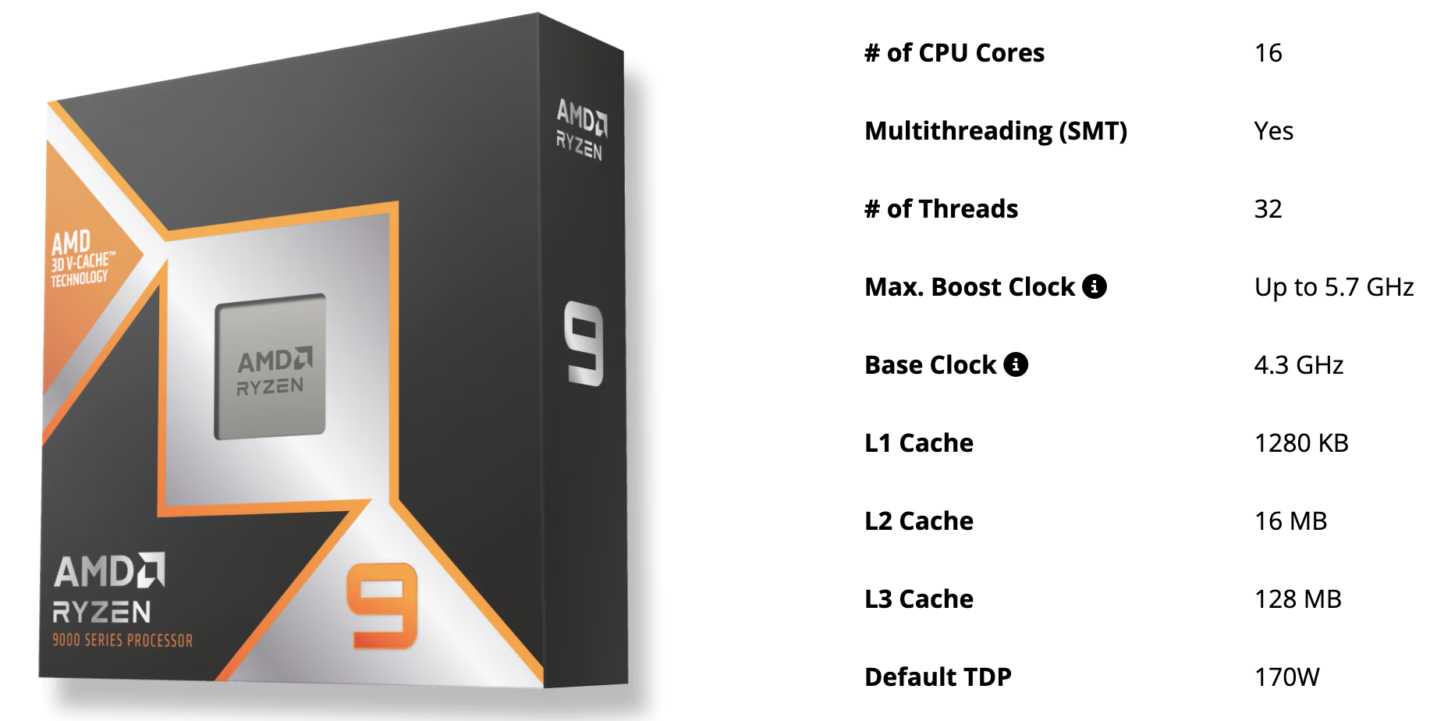
Motivation
Compute is fast!
Look at this CPU, whose clock rate is 4.3GHz
An addition can be done within ~0.23ns

Slide 5
Motivation
Memory is slow in latency: A memory access takes nearly 50-100ns, which is 200-400x slower
(General) Memory Unobtainable Goal
Big to fit all the data
Fast in access
Affordable

Slide 6
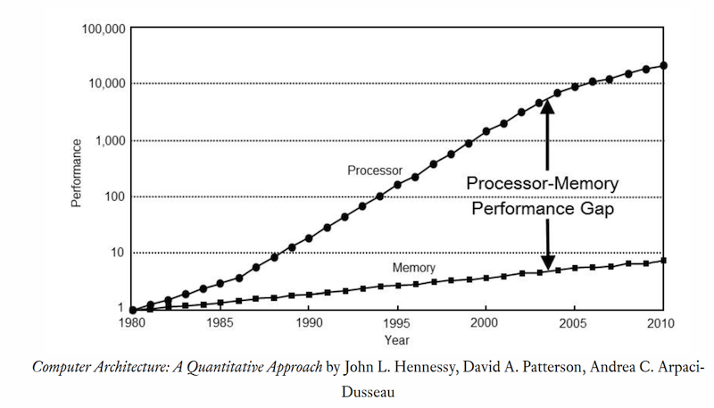
The Memory Wall
Compute grows 1.3-1.5x yearly
Memory? 7%

Slide 7
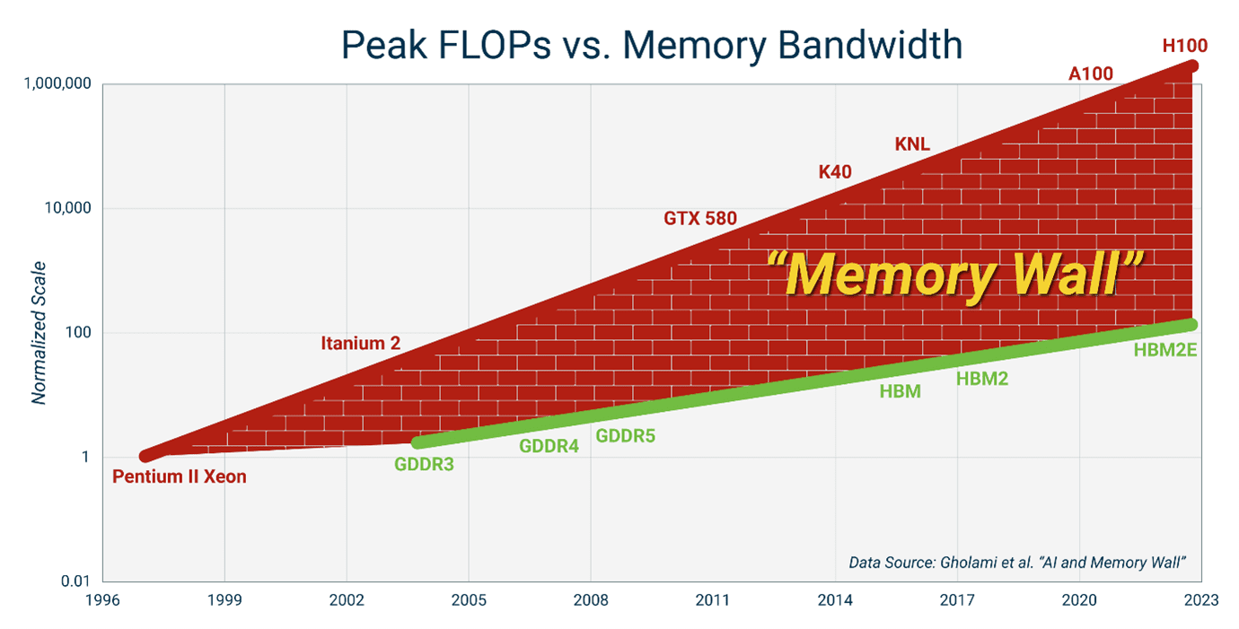
The Memory Wall
The trend is still true today

Slide 8
Storage Hierarchies
Type | Latency | Throughput | Size
Register | 0 | / | ~KB
SRAM | ~1-10ns | ~5TB/s | ~100MB
Memory | ~100ns | ~100GB-3TB/s | ~32GB-2T
Disk | ~1ms | ~0.5GB/s | ~2T-100T
Typically smaller sizes for larger bandwidth and latency

Slide 9
How does cache benefit?
Capture memory accesses’ locality
Temporal Locality
Memory accessed within a brief time period will be frequently accessed again
Spatial Locality
Memory near the memory accessed will be frequently access again
👉🏻 True for both data and instruction
I$ & D$

Slide 10
What does cache do?
Read/write the data does not just bring the data from the memory
Also bring the whole block into a cache
Next time, read from cache to save time when accessing again
This saves traffic from memory
What is traffic?
Mem
CPU
L1

Slide 11
How does cache benefit? (CONT’D)
Recap what we had in speculative execution
Penalty: Cannot worse than bubbles
Benefit: Execute instruction early
What about cache?
Care! We do have penalties on mis
%_{mis} * (lat_{cache} + lat_{mem}) + %_{hit} * lat_{cache}

Slide 12
Cache Architecture
Core 0
Core 1
Private L1
We focus on private L1 cache first
We focus on L2 read today
Write later
Caches are transparent
Caches are hidden!
GPU scratchpad are reconfigurable
48KB=16KB+32KB
Scratchpad: sw managed
Cache: hw managed
L1
L1
L2
L2
LLC shared across cores
GPU-SM
L1

Slide 13
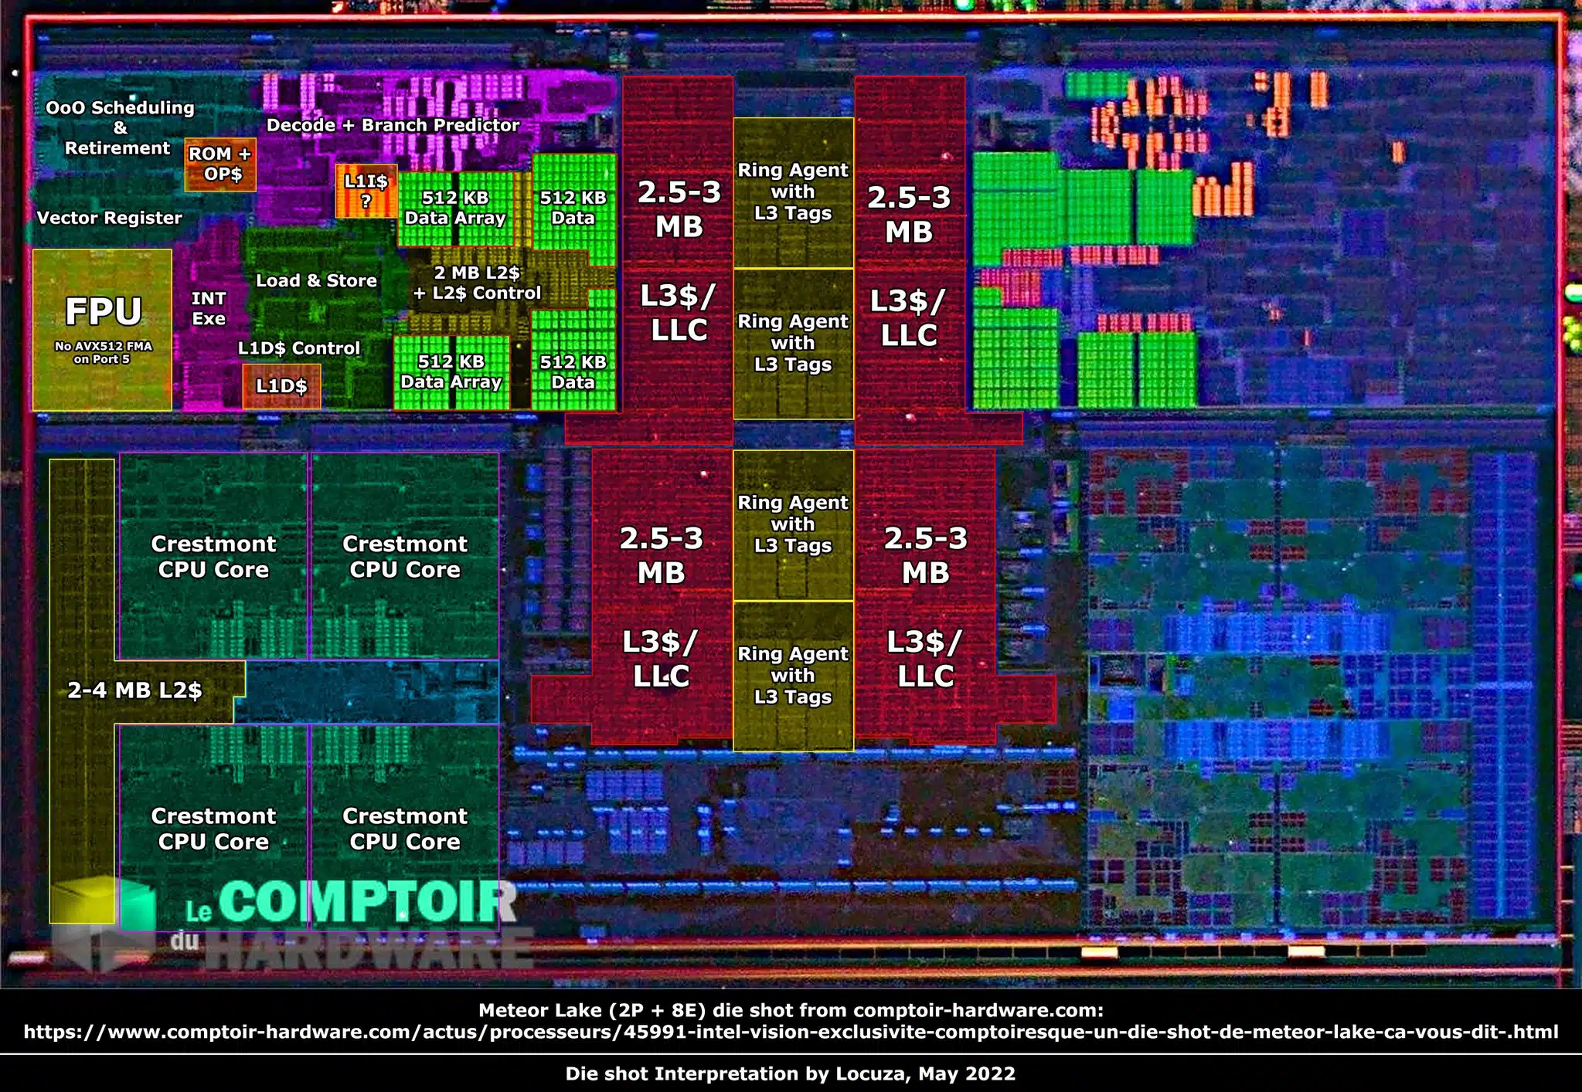

Slide 14
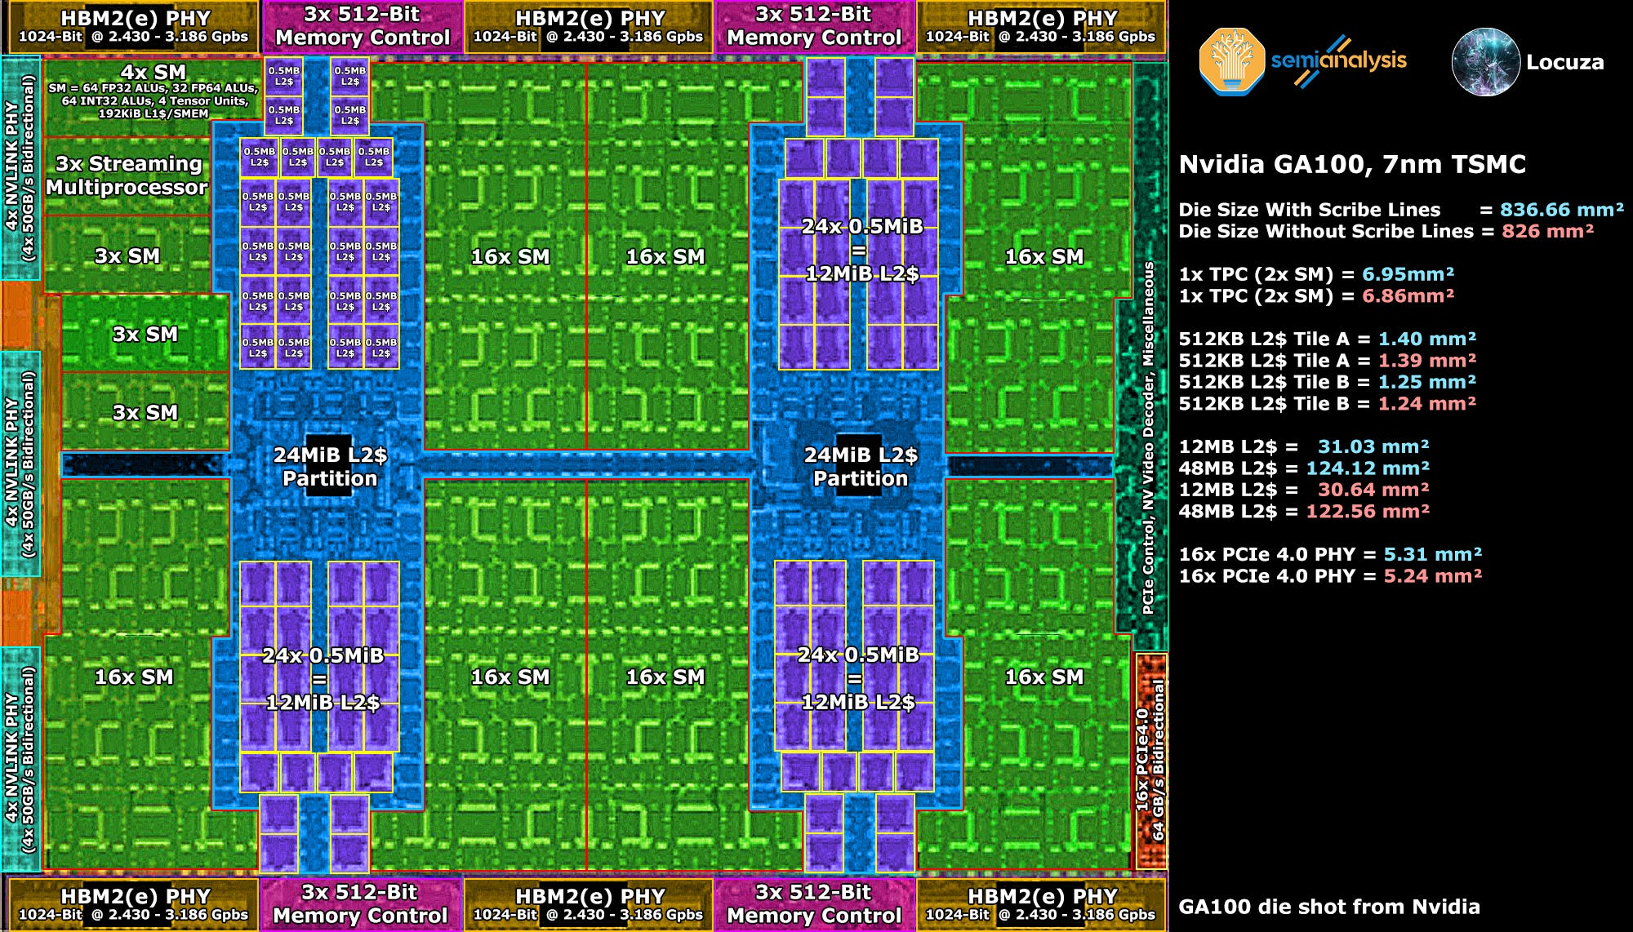

Slide 15
More on Storages
Static Random Access Memory (SRAM)
6 transistors per bit (depends)
Optimized for speed and less optimized for density
Fast: Speed and energy saving proportional to area
Mixes well with compute logics
Dynamic RAM (DRAM)
1 transistor and 1 capacitor per bit
Optimized for density
Slow (>40ns for internal access and >100ns for pin-to-pin)
Hard to integrate with logics

Slide 16
More on Storages (CONT’D)
DRAM
DRAM read is destructive
A memory read destructs the data in memory
Read data will be broadcast to both response and write back to retain the data
Which is another key reason DRAM is slower
Both DRAM and SRAM are volatile
Disks are non-volatile
So called NVM, non-volatile memory

Slide 17
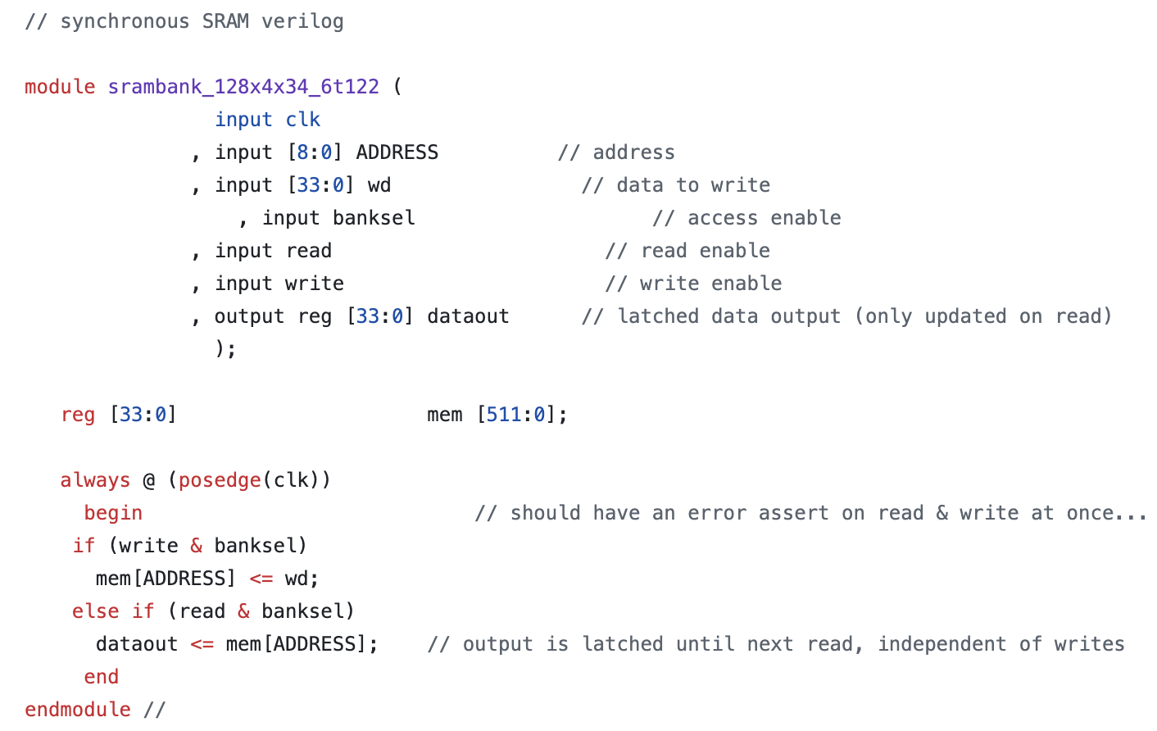
IP Blackbox
SRAM blackbox from ASAP lib

Slide 18
IP Blackbox
Key difference: SRAM has 1-cycle latency w/ fixed data width, 33-bit
Why 33? Maybe for valid

Slide 19
Question: What if I want wider data access?
A cache line is 256-bit, how?
Combine more of these blackbox blocks and concatenate them.
This is called interleaving.
0
1
2
…
7
0
1
2
7
Bank 0
Bank 1
Bank 2
Bank 7
…

Slide 20
Question: How are these banks connected?
H-tree
A recursive topology to minimize the wire length
Each node looks like a H

Slide 21
A Basic Cache Structure
Cache: An array of blocks
Each block/cacheline is 32-byte/32B
A 32KB cache has in total 1024 blocks
To find the block
How?
Slice the address
Tag[31:15]
Index[14:5]
Offset[4:0]

Slide 22
A Basic Cache Structure (CONT’D)
Slice the address
Offset
Each block is 32-byte, 2⁽⁴⁻⁰⁾⁺¹=32
Index
In total 1024 blocks, 2⁽¹⁴⁻⁵⁾⁺¹=1024
Tag
31-15+1=16 bits
Tag[31:15]
Index[14:5]
Offset[4:0]

Slide 23
Indexing a Cache Entry
Consider a simplest case 1-way associative
Tag[31:15]
Index[14:5]
Offset[4:0]
Addressable Cache w/ 1024 Entries
=
Tag in Cache [31:15]
&
Valid
Data in Cache 32-Bytes

Slide 24
Indexing a Cache Entry
Just like read an array from an array 🤦🏻‍♀️
Tag[31:15]
Index[14:5]
Offset[4:0]
Addressable Cache w/ 1024 Entries
=
Tag in Cache [31:15]
&
Valid
Data in Cache 32-Bytes

Slide 25
Indexing a Cache Entry
The array entry can be broken down into 3 fields
Tag[31:15]
Index[14:5]
Offset[4:0]
Addressable Cache w/ 1024 Entries
=
Tag in Cache [31:15]
&
Valid
Data in Cache 32-Bytes

Slide 26
Indexing a Cache Entry
The array entry can be broken down into 3 fields
Tag[31:15]
Index[14:5]
Offset[4:0]
Addressable Cache w/ 1024 Entries
=
Tag in Cache [31:15]
&
Valid
Data in Cache 32-Bytes

Slide 27
Wait… Isn’t Tag and Valid Bit overhead?
Yes.
In total: 32B + 1-bit valid + 16-bit tag = 273
Overhead: 17 + 1 = 18
Overhead(%): 18 / 273 ≈ 6.6%
Quiz: What is the overhead of having 48-bit address?

Slide 28
Associativity
Associativity: Say, 4 way. OK, four duplications of this.
Tag[31:15]
Index[14:5]
Offset[4:0]
Addressable Cache w/ 1024 Entries
=
x4
Tag in Cache [31:15]
&
Valid
Data in Cache 32-Bytes

Slide 29
Associativity
Associativity
Say, 4 way. OK, four duplications of this.
Even more associativity? More on this later.
It badly hurts the latency
Read out 4 entries in //
Additional logics:
Select the one matches: If no one matches, miss!
Select the one to kick out when associativity is full

Slide 30

Hill’s 3C Miss Rate of Caches
Compulsory
1st time of access
Capacity
Missed caused by capacity
I will give you an example later (your homework)
Conflict
Caused by finite associativity
I will also give you an example later

Slide 31
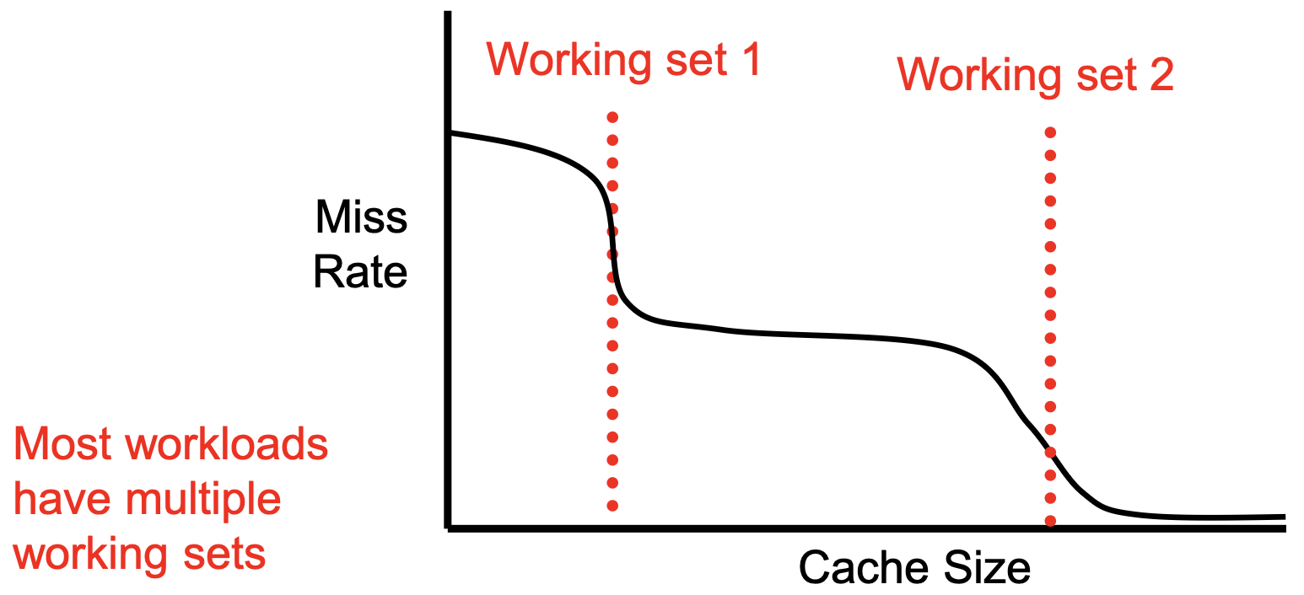
Cache Size
Increasing cache size always helps
Correct non-sense
But with diminish returns
Cache buffering is in the granularity of working sets

Slide 32
What is working set?
An example of matrix multiplication
If you do a naïve matrix multiplication, the working set is 3N², A, B, and C
A
B
C
=

Slide 33
Can we have a better working set?
Linear algebra taught us we can block-ize the matrix multiplication
Say, we have a block, 32×32
B
A
C
A_{0,0}
A_{0,1}
B_{0,0}
C_{0,0}
=
B_{1,0}

Slide 34
Temporally and Spatially Local
Say, we have a block, 32×32
When accumulating the submatrix C_{0,0}, we have a working set of 3×(32×32) for each K
B
A
C
A_{0,0}
A_{0,1}
B_{0,0}
C_{0,0}
=
B_{1,0}

Slide 35
Temporally and Spatially Local
Say, we have a block, 32×32=1024
32×32×4B = 4kB, 3 matrices = 12kB
Hopefully, it fits in a local L1
B
A
C
A_{0,0}
A_{0,1}
B_{0,0}
C_{0,0}
=
B_{1,0}

Slide 36
From a Traffic View
The bigger block, the more reuse as I discussed before
Say, n² size of block, we have 3n² of work set
3n² traffic from DRAM to L1: Less favor but inevitable
n³ traffic from L1 to core: More favored trying to maximize
B
A
C
A_{0,0}
A_{0,1}
B_{0,0}
C_{0,0}
=
B_{1,0}

Slide 37
We are not done yet!
Look at these blocks in a fine-grain view.
B is still accessed in column major
Transpose B in each submatrix
A
B
C
A_{0,0}
A_{0,1}
B_{0,0}
C_{0,0}
=
B_{1,0}

Slide 38
Homework: Optimize a GeMM
I believe you do not need to do SIMD, the compiler will transform it for you.
Just make a good scope of working sets.
Maybe I should as TA for an online judge.
Say, we do a 2048³ with O3 enabled for 0.5s time limit

Slide 39
Block Size
Bigger block
More conflicts: Fewer entries
Fewer first access miss
May increase the latency when missing
Fewer bits on indexing, more bits on offset
Tag unchanged
Fewer entries & Tag unchanged: Lower overhead
Tag[31:15]
Index[14:5]
Offset[4:0]

Slide 40
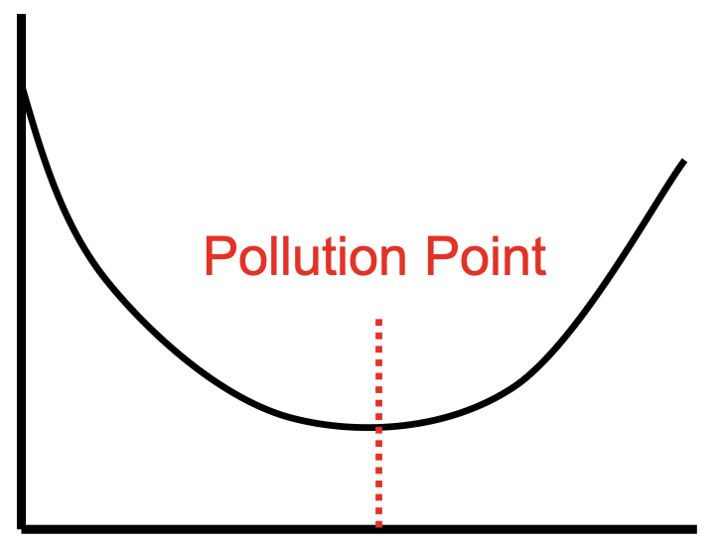
Block Size (CONT’D)
Block size
Bigger blocks for better continuous or adjacent access
For worse scattering accesses
For more conflicts
A good block size is 32-128B
Program-dependent
Miss Rate
Block Size

Slide 41
Conflict (w5d1/transpose.c)
To my surprise, I can still replicate this on an laptop produced in 2023
Transpose an 1024x1024 array
100%
Transpose an 1023x1023 array
-2047: -2 less works
Transpose an 1025x1025 array
2049: 2% more works
How much execution time differences will we have?

Slide 42
Conflict (CONT’D)
N=1024, i*N+j is too perfect aligned with cache way associativity, which causes associativity conflict to frequently kick out and bring in values.
What should we do?

Slide 43
Way-Skewed Cache
Each way we can use a different function to allocate different entries of cache
Index[14:5]
Index[14:5]
Index[14:5]
Skew Function 1
Skew Function 2
Skew Function 3
Cache Assoc. Way 1
Cache Assoc. Way 2
Cache Assoc. Way 3

Slide 44
Overwhelming Conflicts
When having too many blocks mapping to a same way, what should we do?
Kick out.
Kick out who?
Furthest used in the future
Dude, there is no magic in this world

Slide 45
Overwhelming Conflicts
Some realistic options
FIFO
Least recently used
A good heuristic for temporal locality
Not most recently used
Remember the index of most recently used
Kick anyone but this one
Not recently used
Randomly clear the associate bit
Set this bit when used

Slide 46
Fully Associative Caches
We CANNOT do this ☹ for the cost reason
Tag[31:15]
Index[14:5]
Offset[4:0]
Addressable Cache w/ 1 Entries
=
x1024
Tag in Cache [31:15]
&
Valid
Data in Cache 32-Bytes

Slide 47
Fully Associative Caches (CONT’D)
A built-in comparator in near memory
=
Addr [31:5]
Data
Still, we cannot do 1024-way assoc.
Luckily, in most cases we do not need it.
=
Addr [31:5]
Data
…
…
=
Addr [31:5]
Data
=
Addr [31:5]
Data
Request

Slide 48
Design Decision: Separate Tags and Data
This is still expensive
Tag[31:15]
Index[14:5]
Offset[4:0]
Addressable Cache w/ 1024 Entries
=
x4
Tag in Cache [31:15]
&
Valid
Data in Cache 32-Bytes

Slide 49
Separate Tags and Data (CONT’D)
This is still expensive
Tag[31:15]
Index[14:5]
Offset[4:0]
Addressable Cache w/ 1024 Tags
=
x4
Tag in Cache [31:15]
&
Valid
Data in Cache 32-Bytes

Slide 50
Separate Tags and Data (CONT’D)
Only 4x logics for tags, and this is slightly more complicated
Way
Index[14:5]
Offset[4:0]
Addressable Cache w/ Data
Tag Valid?
Data in Cache 32-Bytes

Slide 51
Separate Tags and Data (CONT’D)
This introduces one more stage. Can we do best of both? 1 access of data, and separated t/d?
Way
Index[14:5]
Offset[4:0]
Addressable Cache w/ Data
Tag Valid?
Data in Cache 32-Bytes

Slide 52
Separate Tags and Data (CONT’D)
Yes. Everything can be speculative 🤦🏻‍♀️
Predictor
Index[14:5]
Offset[4:0]
Way
Addressable Cache w/ Data
Tag Valid?
Data in Cache 32-Bytes

Slide 53
Limitations of Cache
Dude, magic helps, to some extent
Recap this: A memory access takes nearly 50-100ns, which is 200-400x slower
Caches can mitigate this 200-400 cycles of bubbles
But there is no magic in this world
Recap this also: A 7B LLM is 53GB, while a GPU HBM is 2T, so 2T/53GB<40.
We cannot synthesize more than 40 tokens/s.
Do they contradict? Or how do they work together?

